Slide 1


Make your “File System” a better place

Slide 2
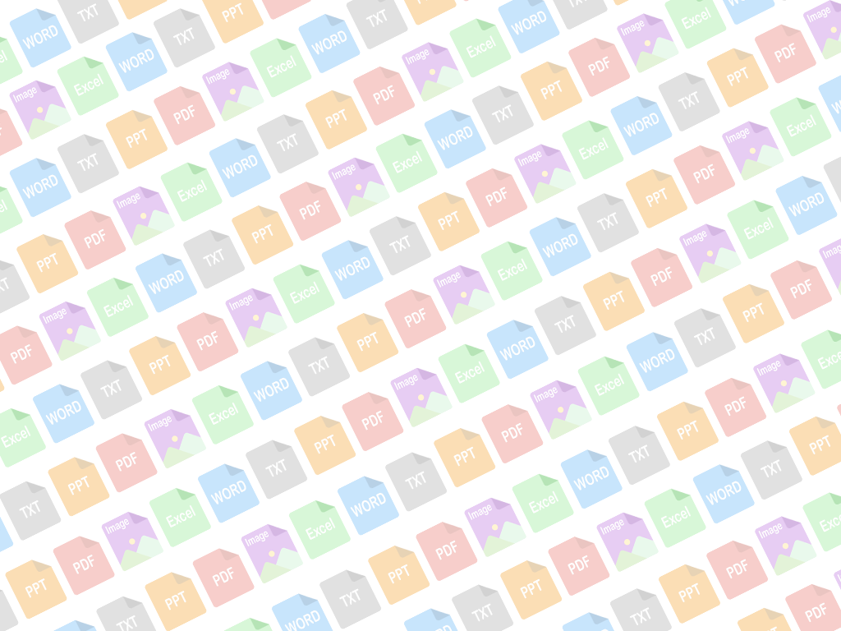
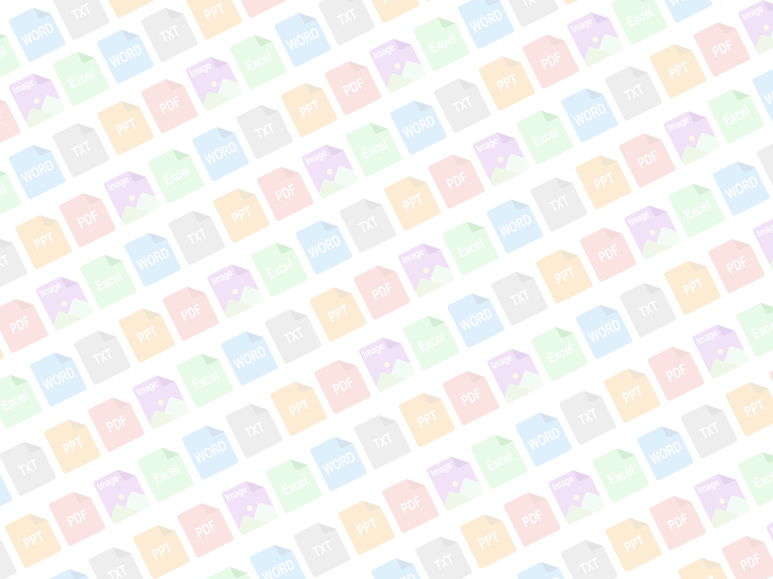
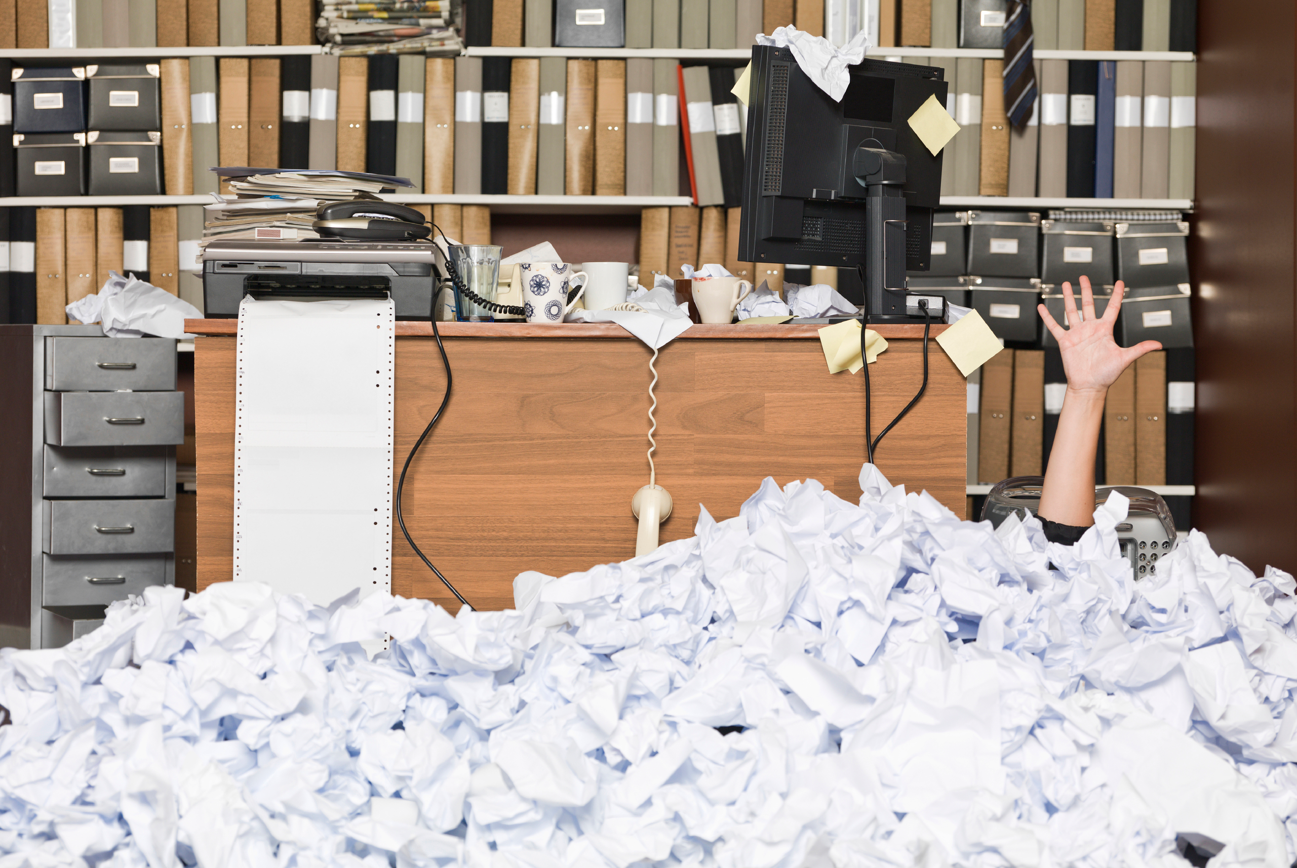
First Day

Slide 3
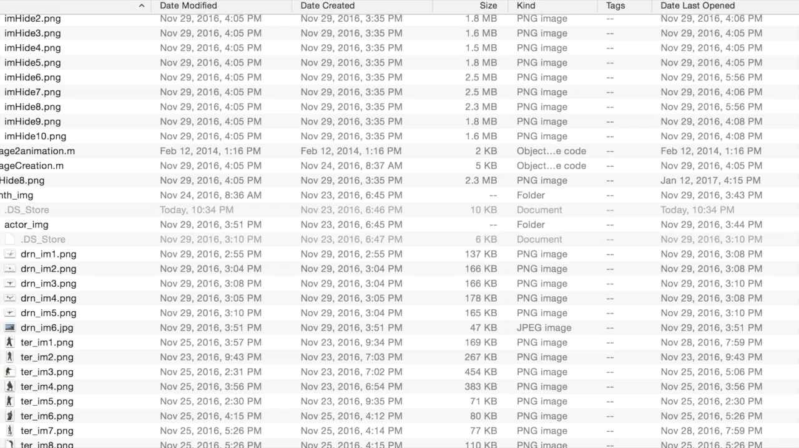
Our File System

Slide 4


Understand
the Content
Semantic
Graphical
Interface

Slide 5
Demo

Slide 6
What’s next?
Analyze Multiple File Types
Define Strong NLP Features for Semantic Graph
Scalable Design and Fast Crawling

Slide 7
GraphiKaL Team

